Slide 1
AKSHAT DOCTOR
Mechanical Design Portfolio
(437) 234-5422
adoctor@uwaterloo.ca

Slide 2
MECHANICAL SECTION

Slide 3
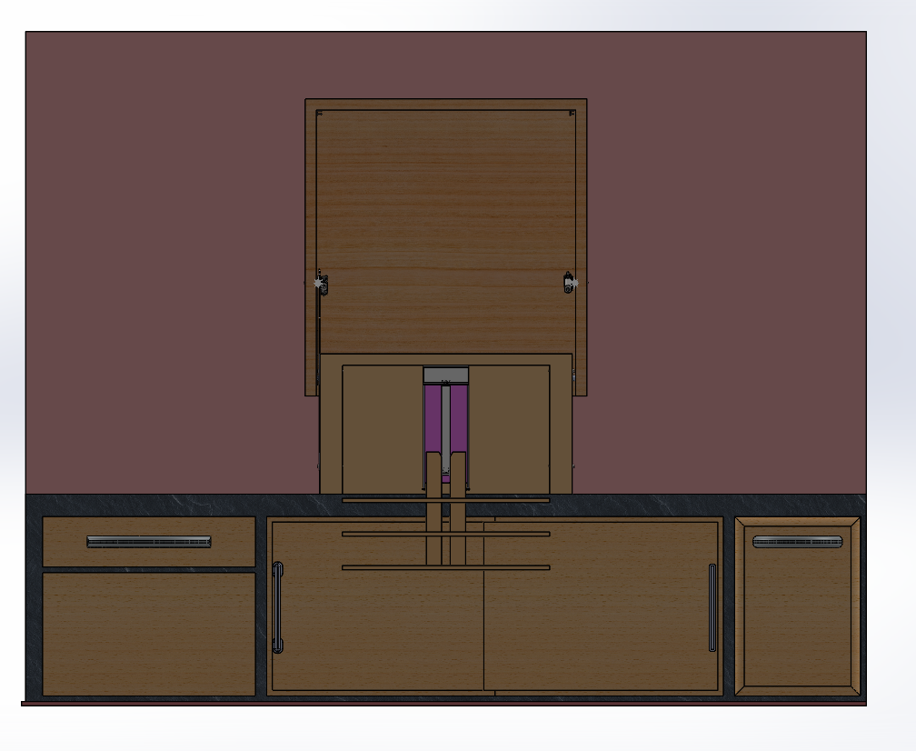
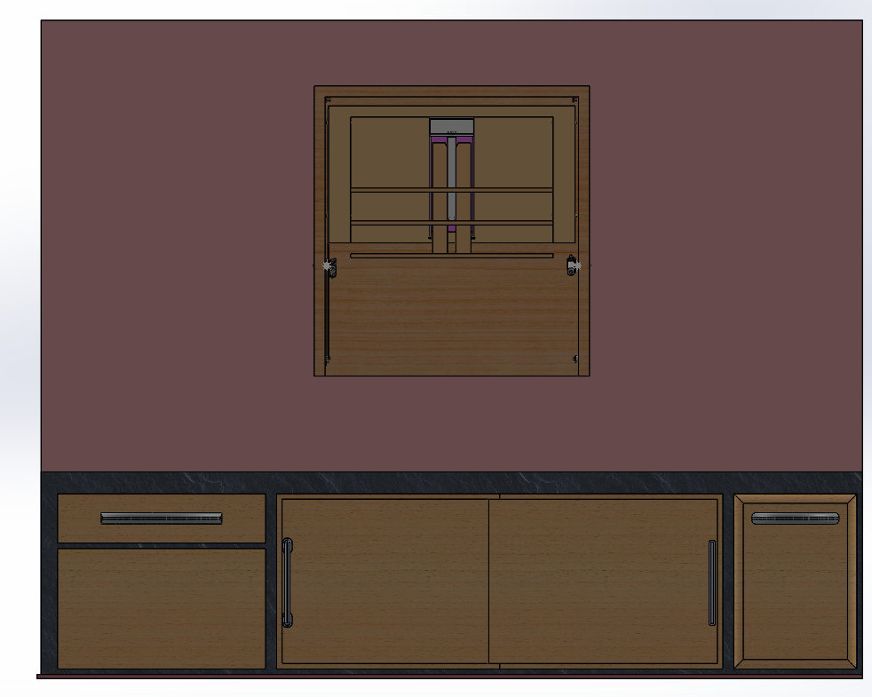
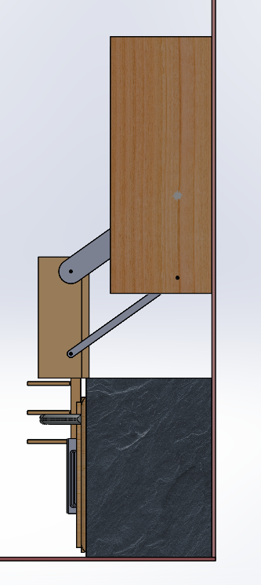
Accessible Shelving Unit
Researched different products that help persons with disabilities act more autonomous in life
Amalgamated the different shelving unit for users unable to reach high standing shelves on SOLIDWORKS
Designed features a 4-bar rotating arms to help with he compactness of the system
Designed belt driven linear descent system for the shelves in order to increase range of shelves

Slide 4
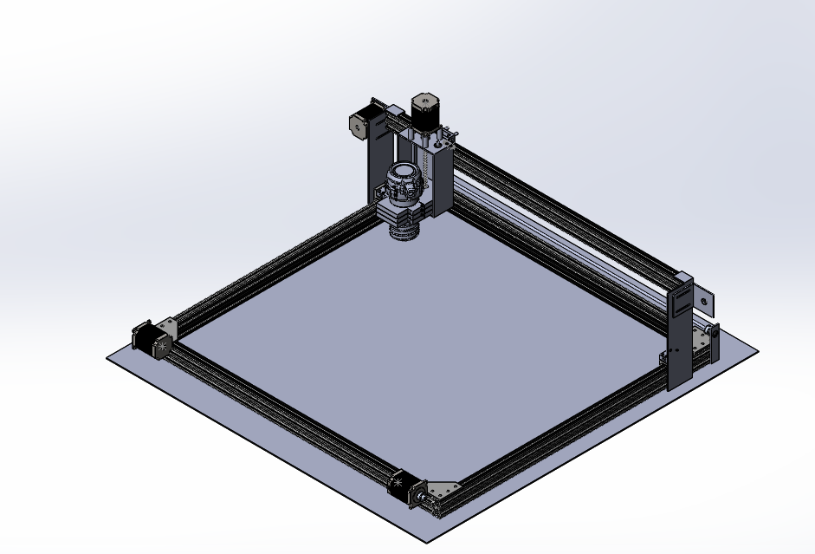
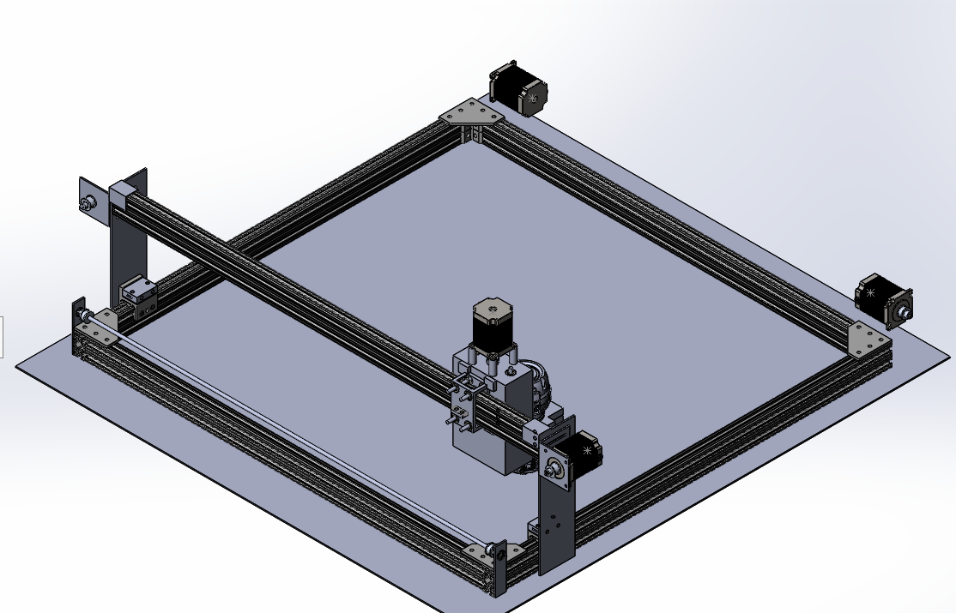
DIY CNC Project
Modelled a 4ft by 4ft CNC Router/Laser Engraving machine using custom plywood parts along with Commercially Off the Shelf(COTS) products on Solidworks
The X-Axis and Y-Axis are belt driven by a NEMA 23 stepper motor as it is a cheaper alternative to a ball screw set-up while still producing a machine resolution of 0.3mm per step
The Z-Axis is lead screw driven by a NEMA 23 in order to gain more resolution and avoid potential slippage problems with a spinning tool

Slide 5
Next Steps
Add electronics and wire routing system for different axis
Review design with engineers/technicians
Create a Bill of Materials for the whole machine
Build the design

Slide 6
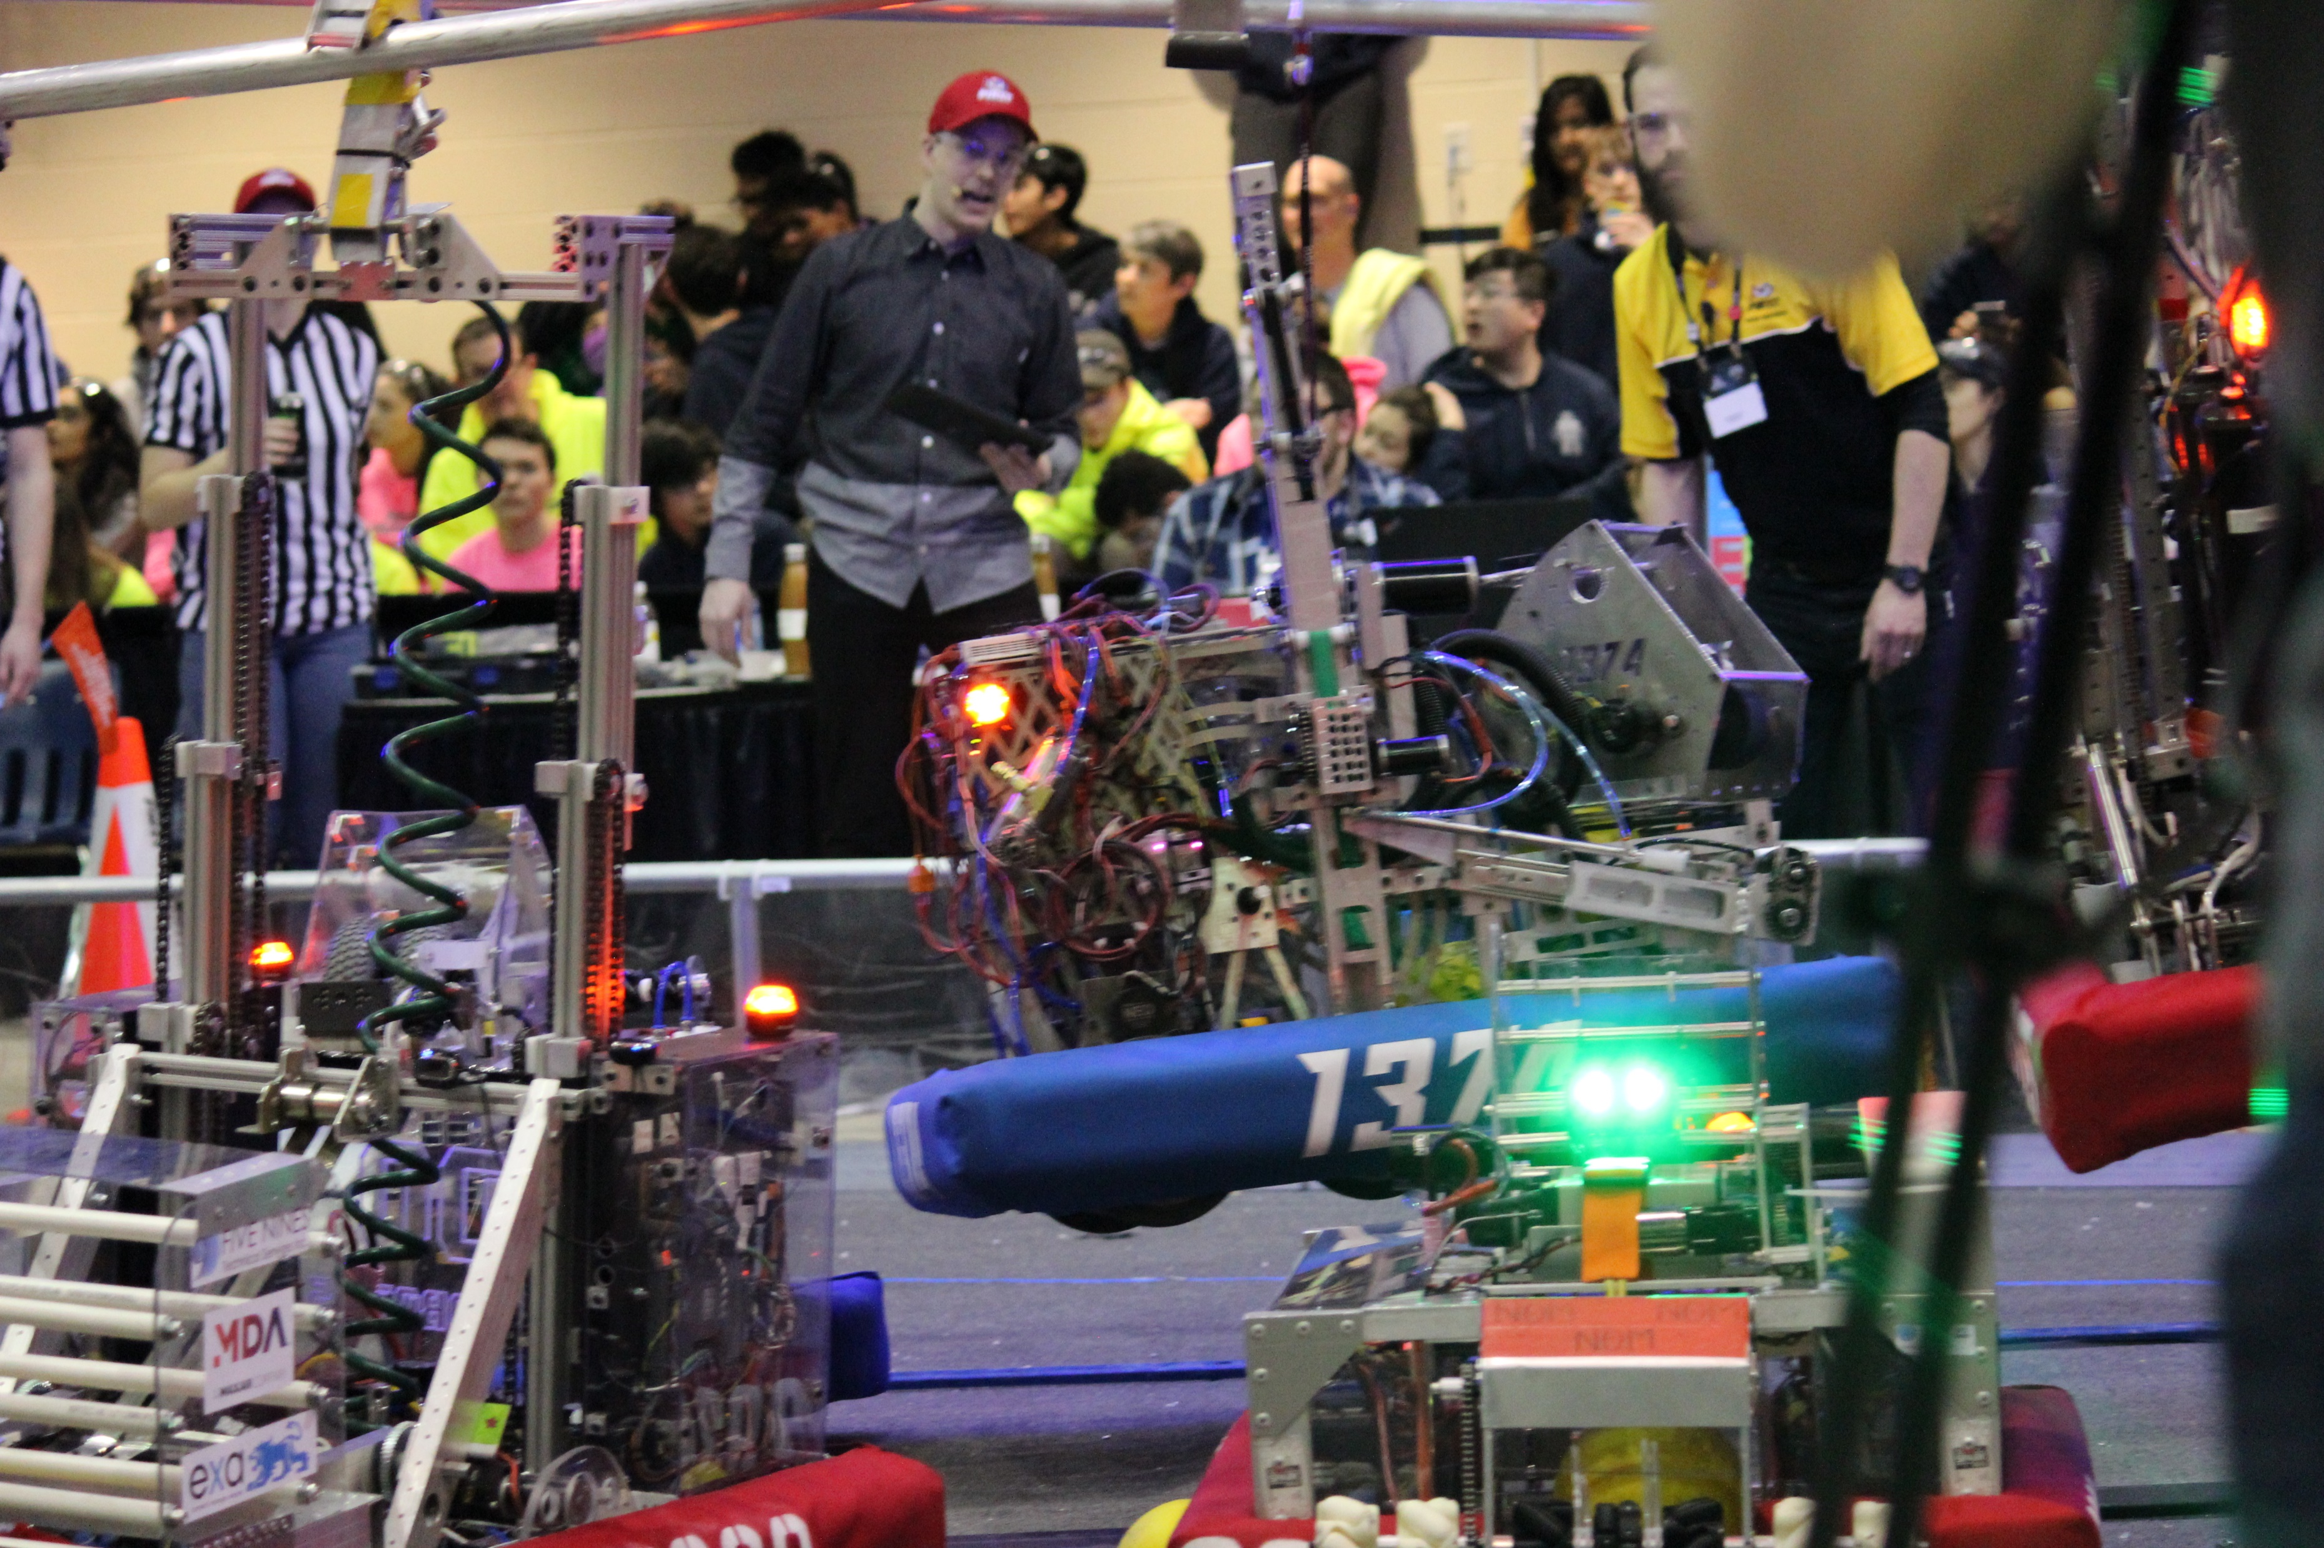
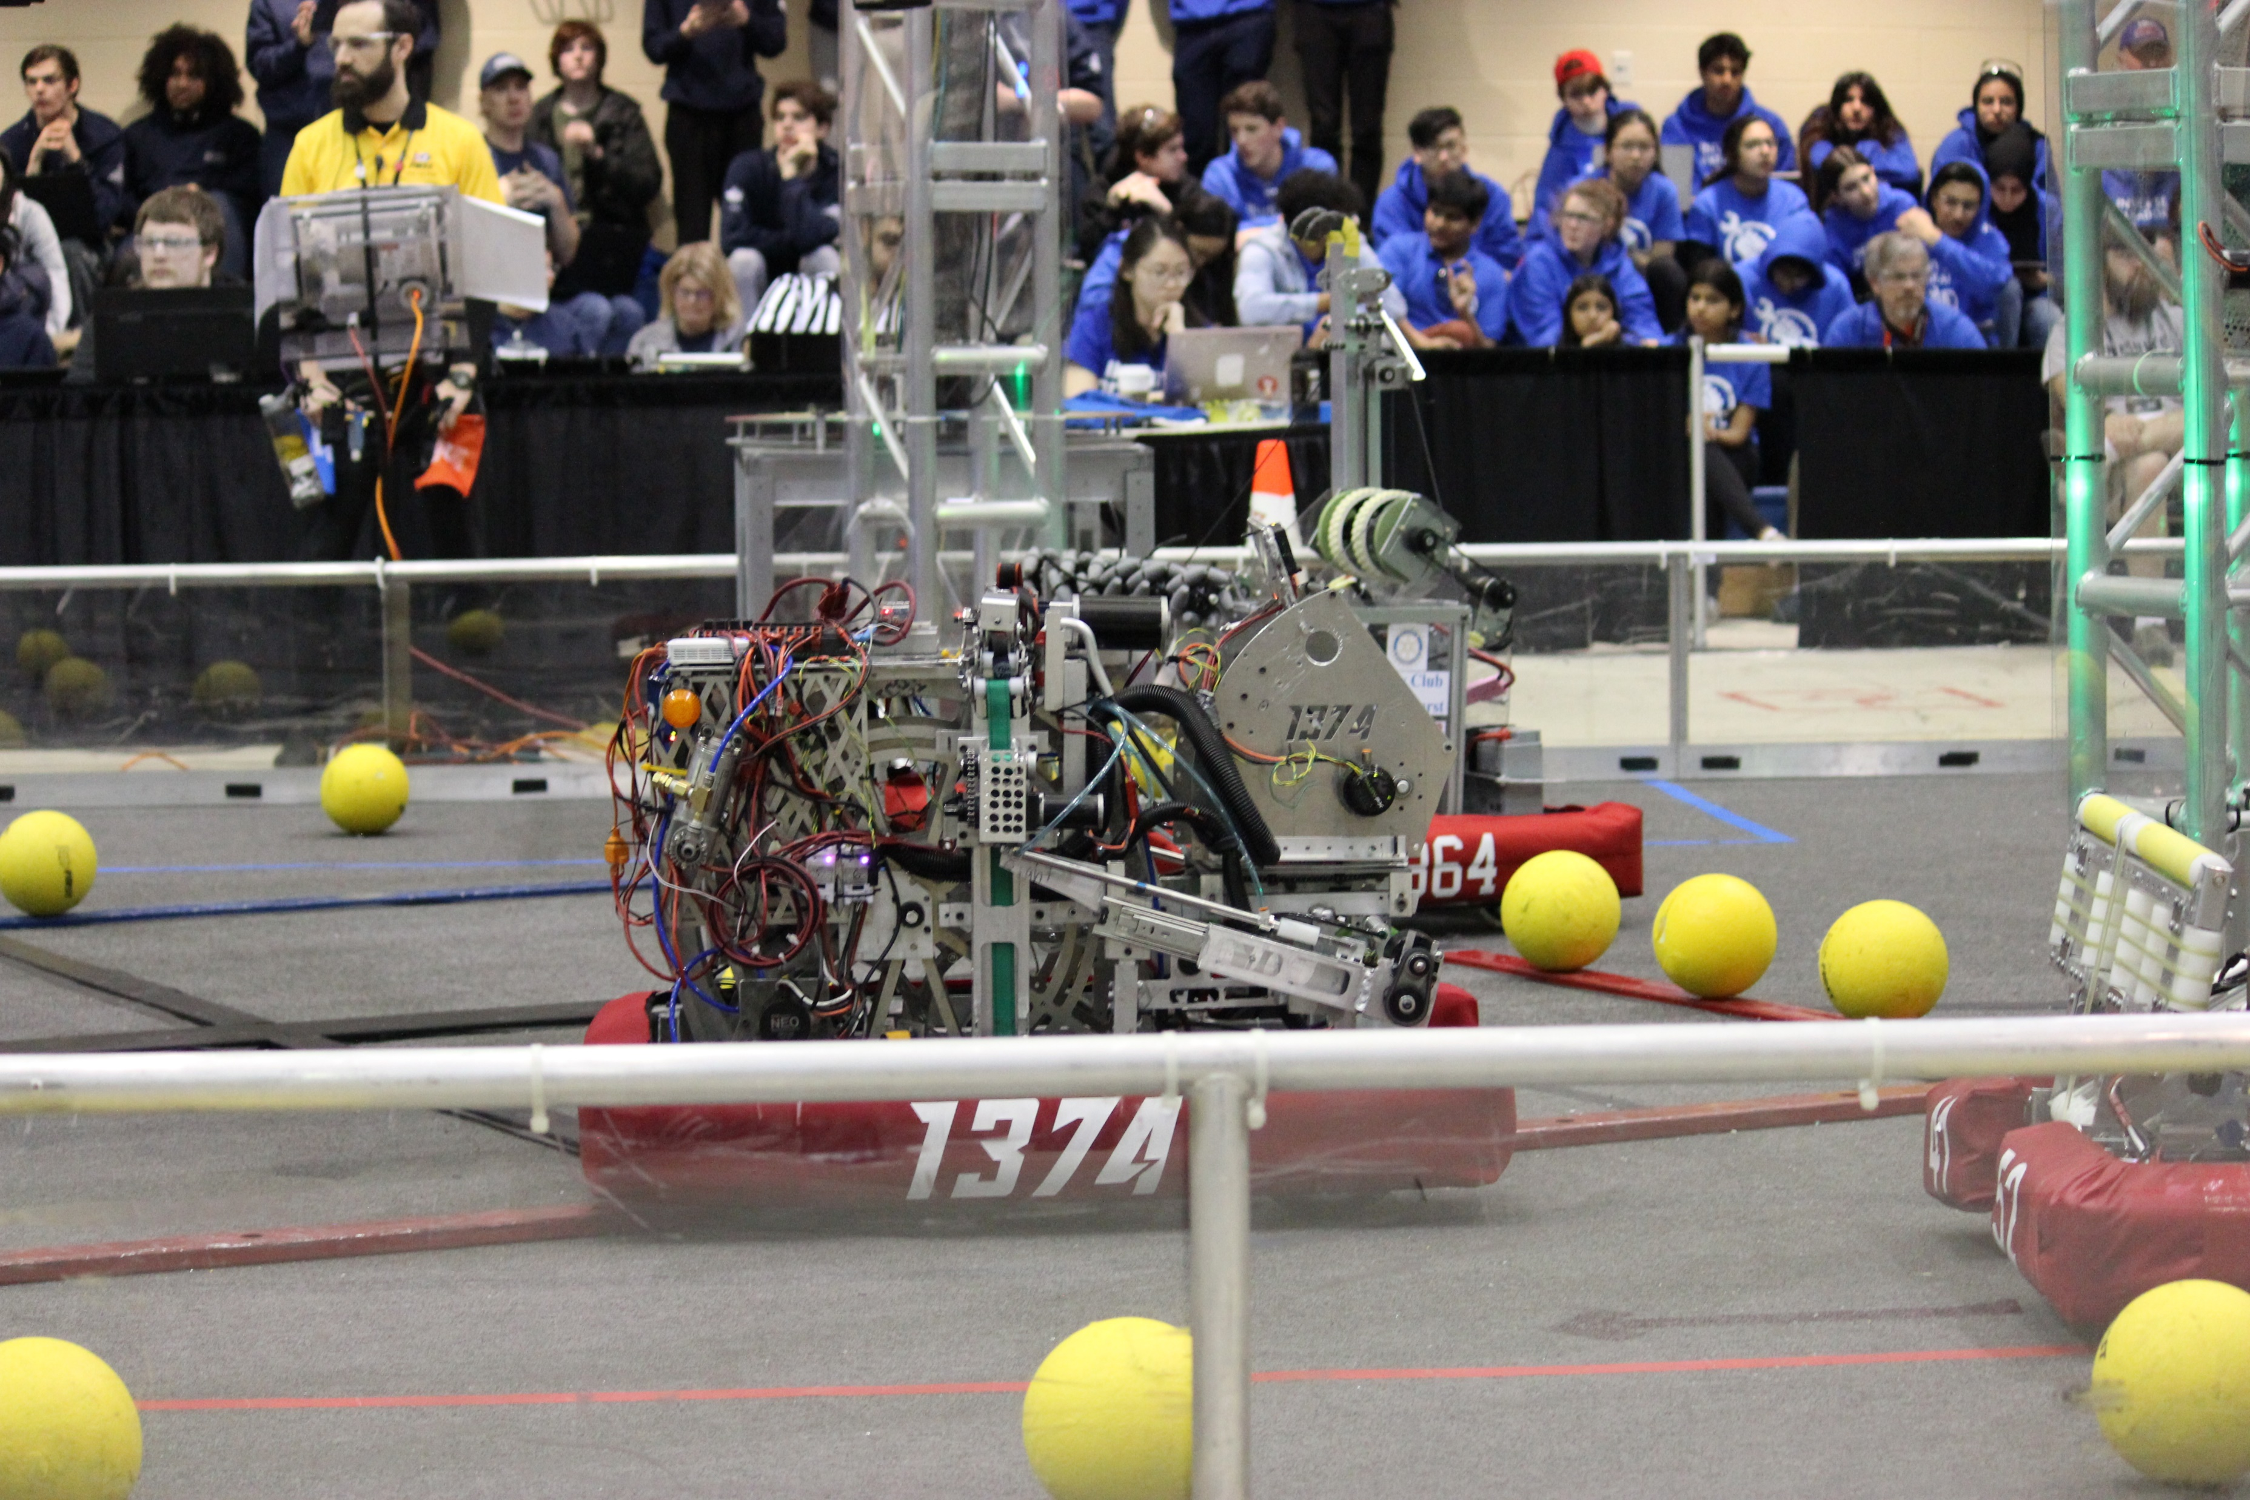
FRC Team 1374 Robot: Climber System
Designed a climbing system for FIRST robotics competition on SOLIDWORKS
Manufactured & Maintained the climber throughout the 8 week competition period

Slide 7
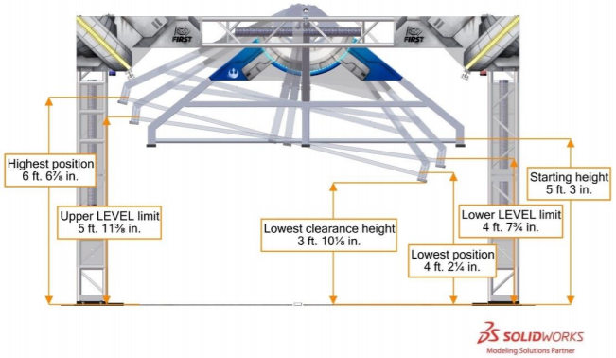
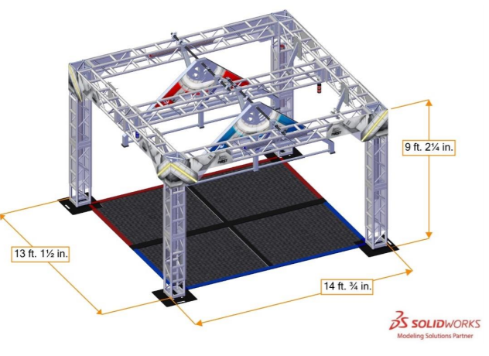
The Goal
Climb the “Generator Switch” (above) during the last 30 seconds of gameplay
The switch changes heights based on where other robots have climbed
The more robots on the team that climb, the more points the team receives

Slide 8
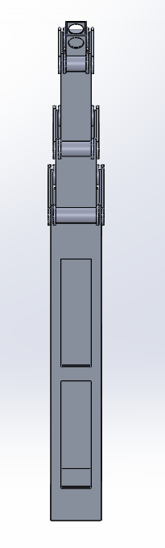
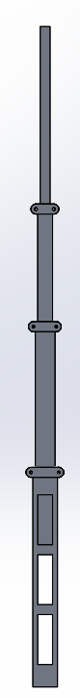
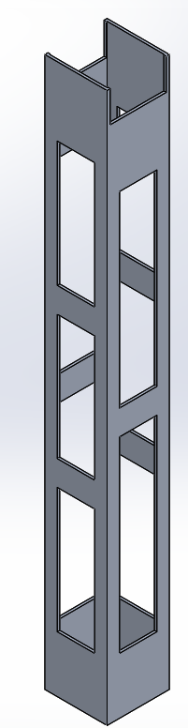
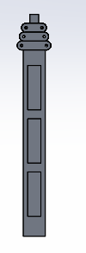
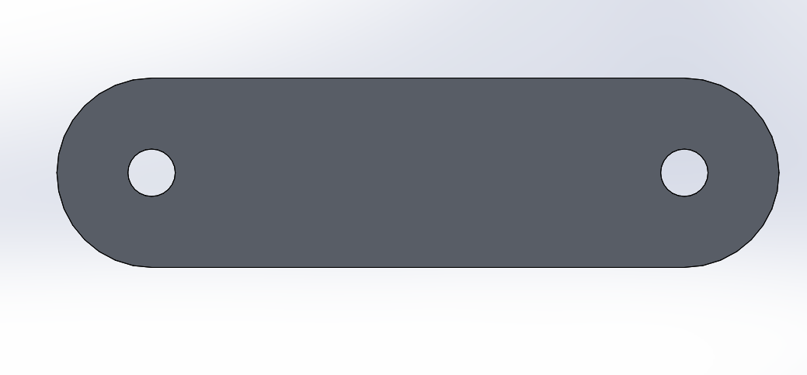
Design of Climber: Tubing
Extended
Focused on creating a compact system to allow for a small and nimble robot
Used four sets of Square 6061 Aluminum Tubing (2.5x2.5in, 2x2in, 1.5x1.5in and 1x1in) to create a telescopic arm
Delrin rollers used on the outside to carry belt rigging and align tubes as structure rose
Used HSMWorks to generate toolpaths and G-Code for slots on tubes
Used Plasma Cutter to create slot profile
Roller View
Compressed

Slide 9
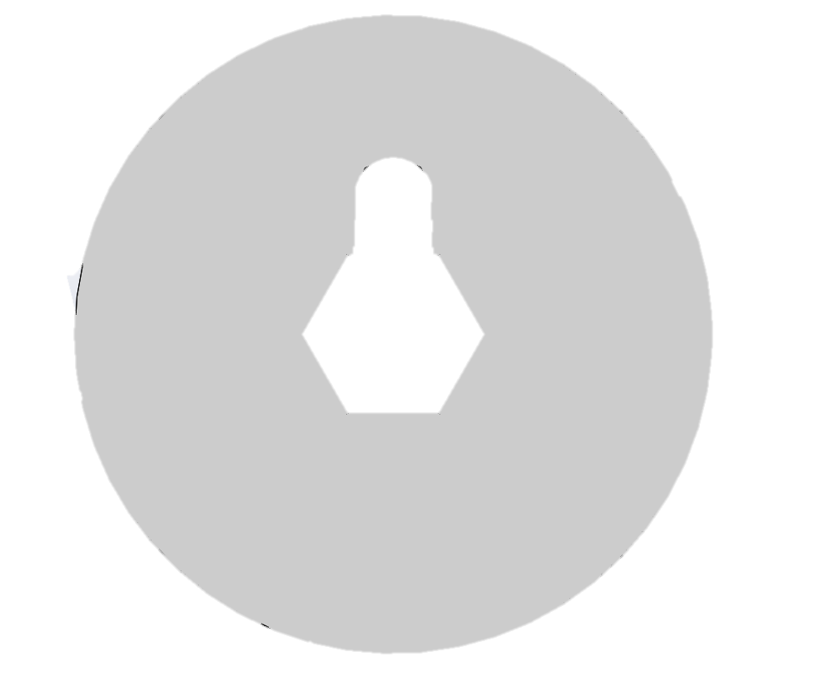
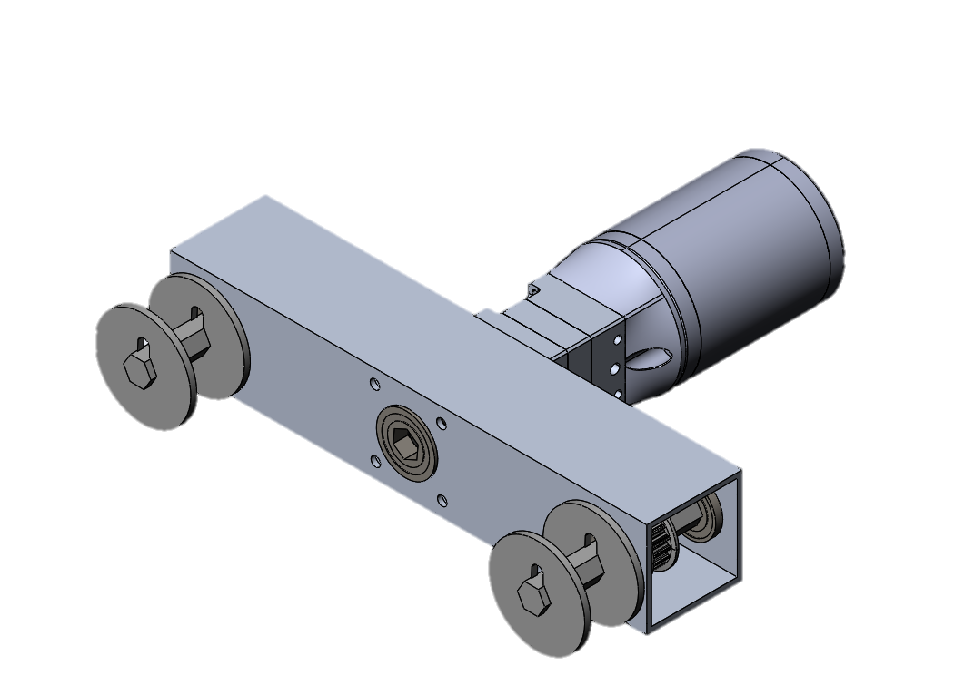
Design of Climber: Winch System
The winch system utilizes a 100:1 brushed DC motor
The gearbox is attached to an axle that contains the winch caps
A pin is placed between caps to hold the belt in place between itself and the axle
Using a ½” Socket, the winch is can be tightened easily
Winch Caps
Winch System

Slide 10
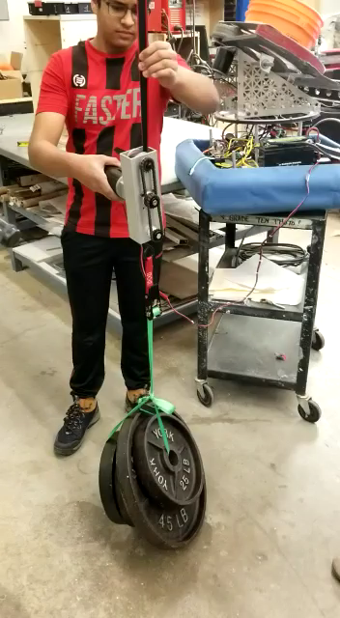
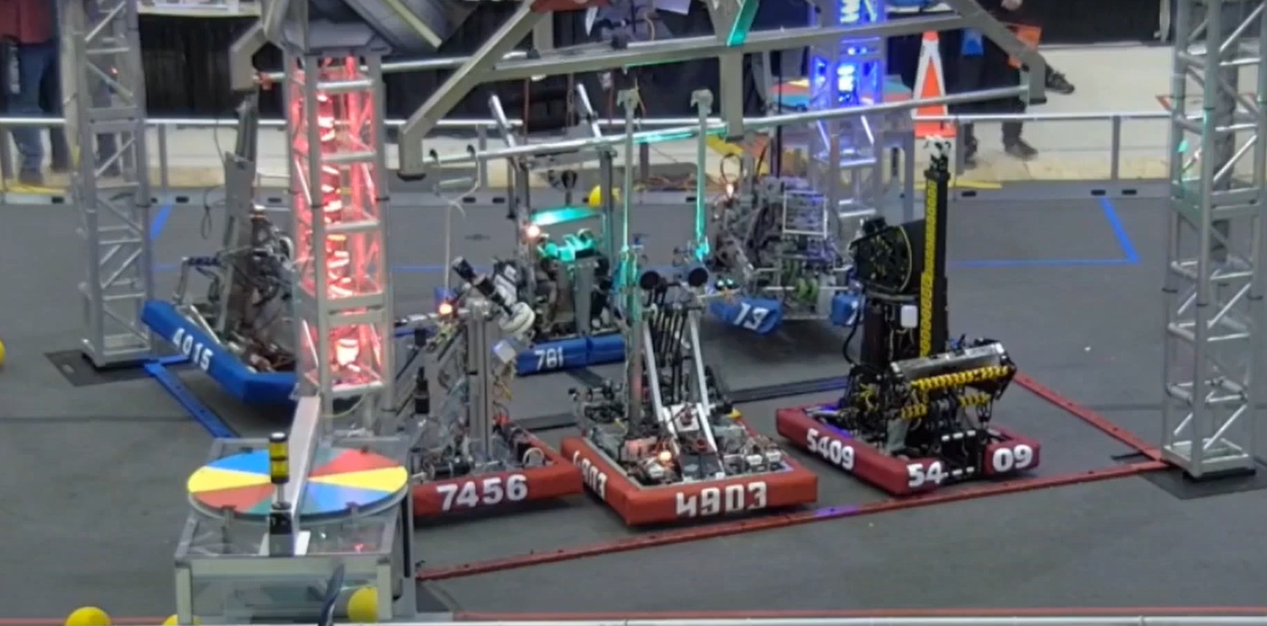
The image on the left is the winch system that was used to pull up the robot. Attached is about 140lbs (the weight of the robot)
The image on the top is a gameplay match where we(1374) climbed with our alliance partners(the other teams in blue). The video is found: here (start at 2:07)

Slide 11
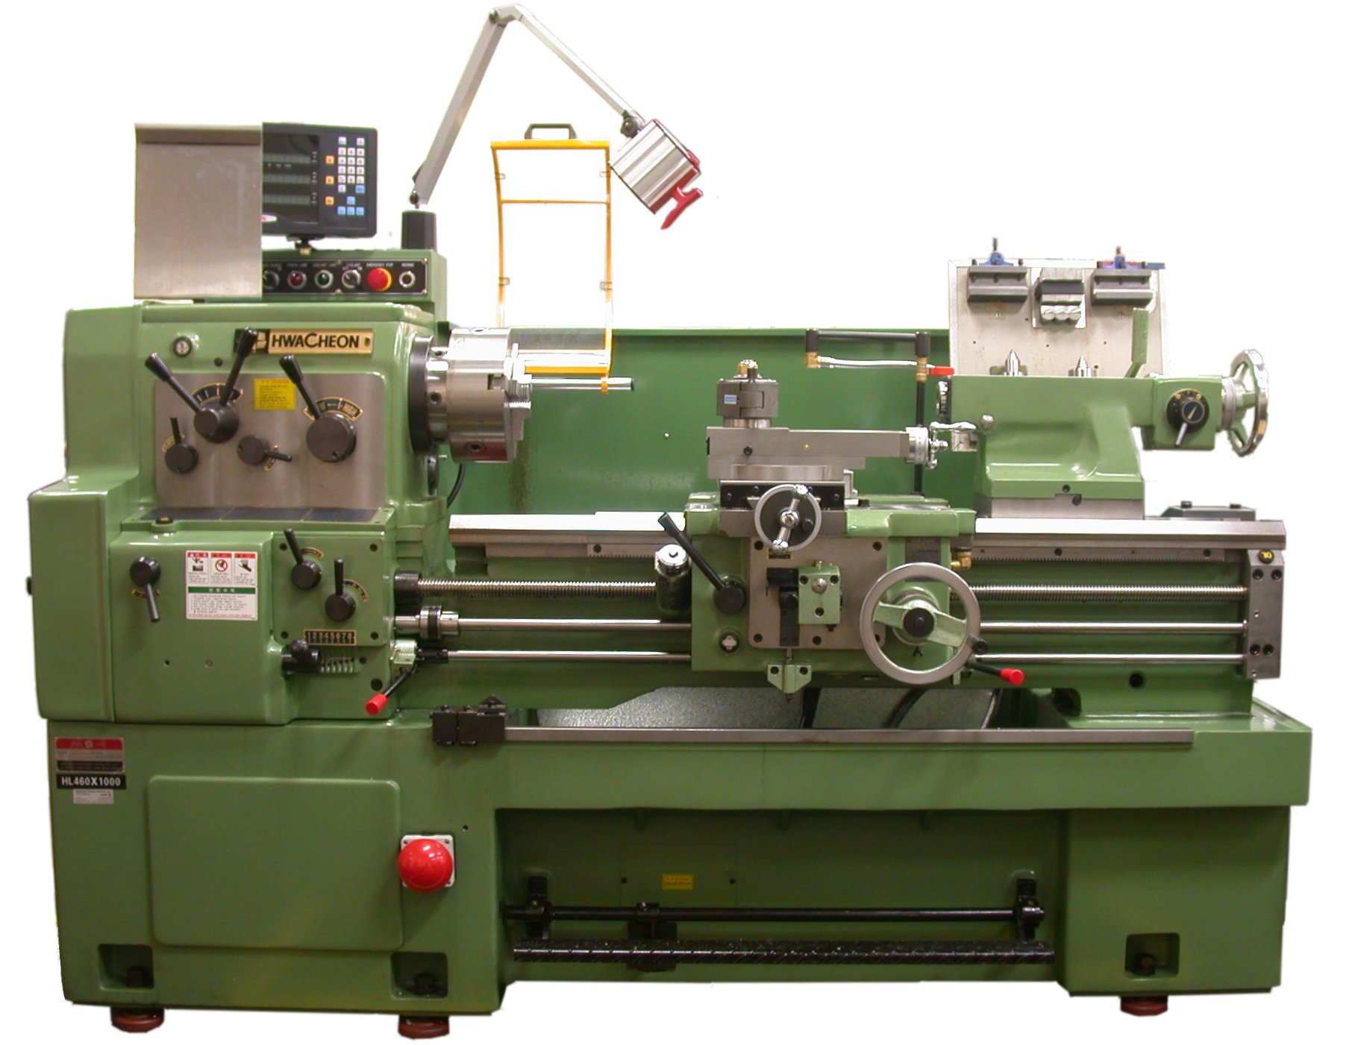
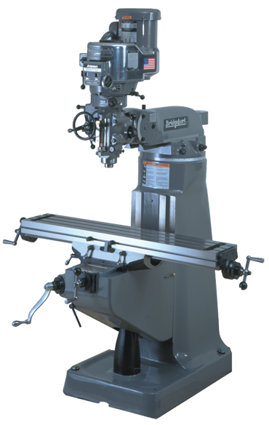
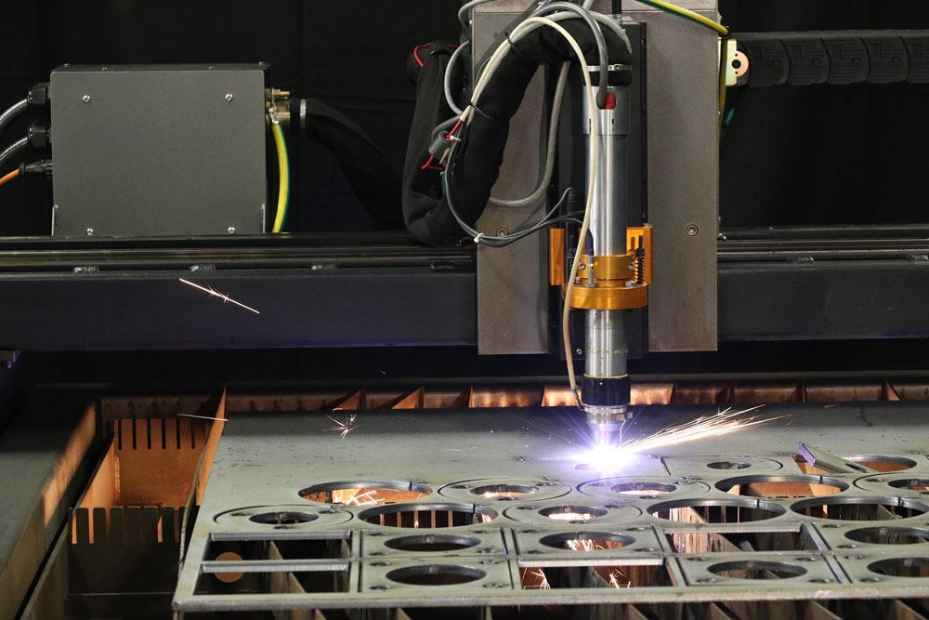
Construction
This climber system was built using a CNC Machine, Vertical Mill, Lathe, Bandsaw, Drill Press, Plasma Cutter, Horizontal Cut-off saw along with hand tools

Slide 12
SOFTWARE SECTION

Slide 13
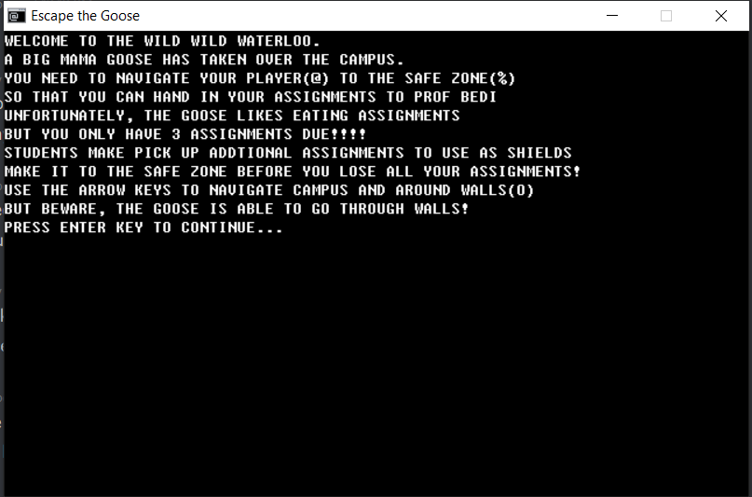
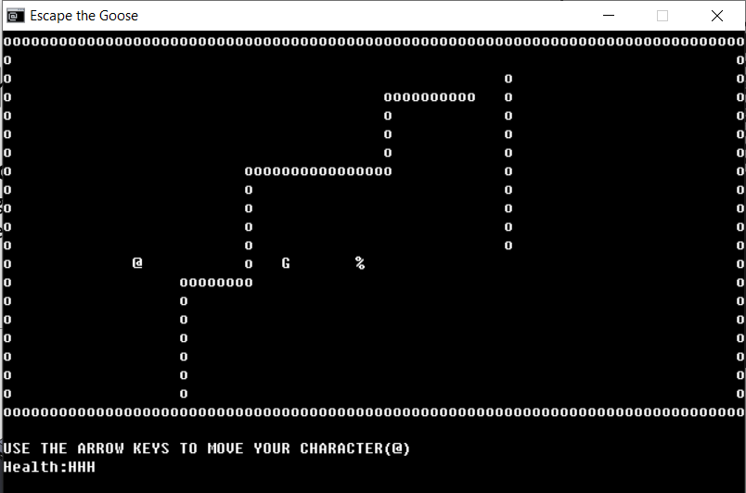
The Goose
Used C++ and BearLibTerminal to create a maze-style game where a player is chased by a Goose
Leveraged OOP to create player objects
Used 2D Array to keep track of movements of the different characters
Read different level layouts from .txt files

Slide 14
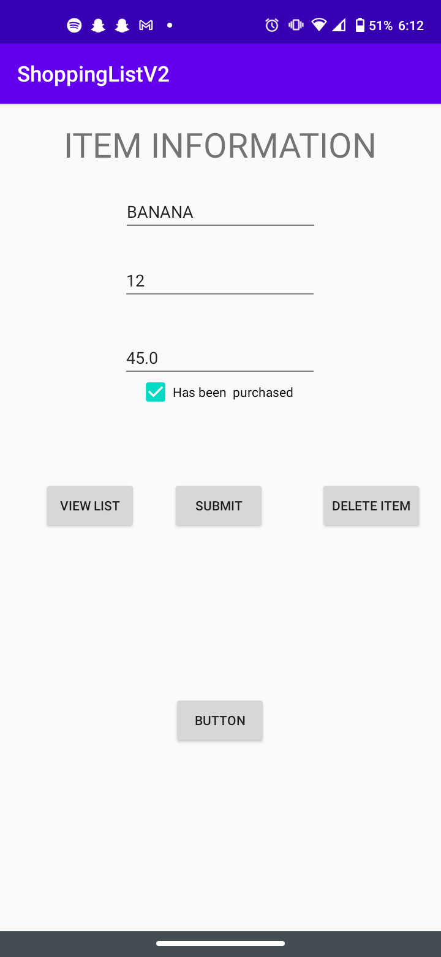
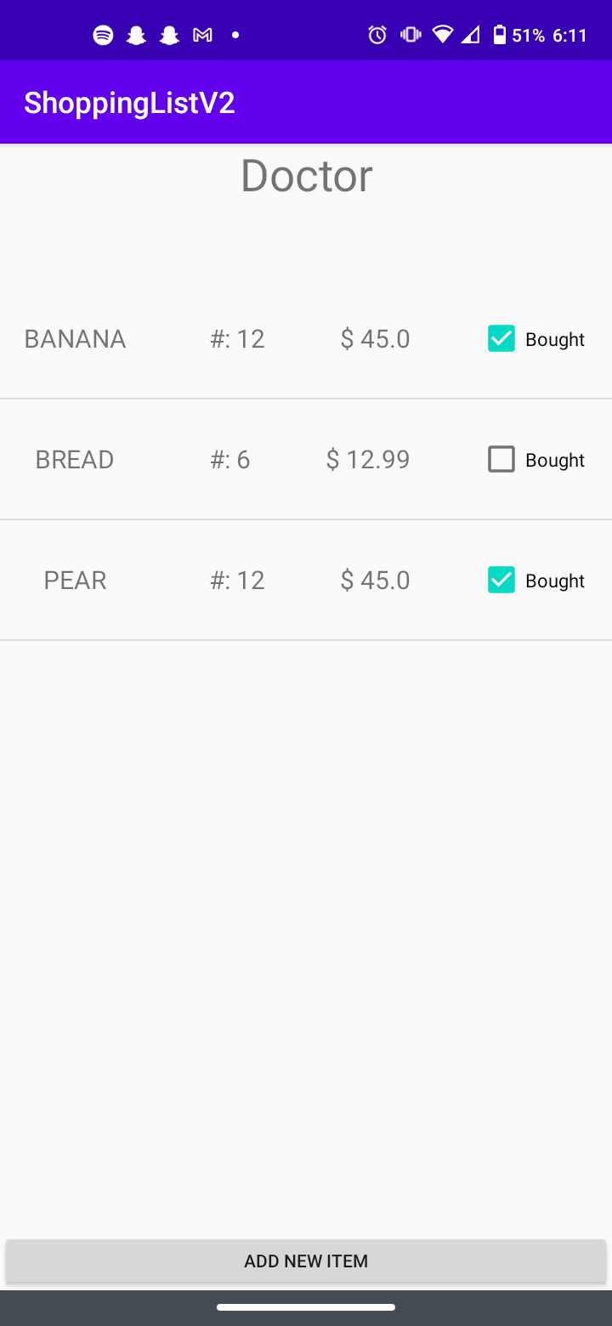
Shopping List
Used Android Studio(Java + XML) to create an android phone app that tracks different household grocery lists
Allows different home users to change item status and quantity
Used Firestore to store user specific lists
Used Firebase Authentication to create email based logins
Used Java OOP to create item templates in order to use ListView and a custom adapter

Slide 15
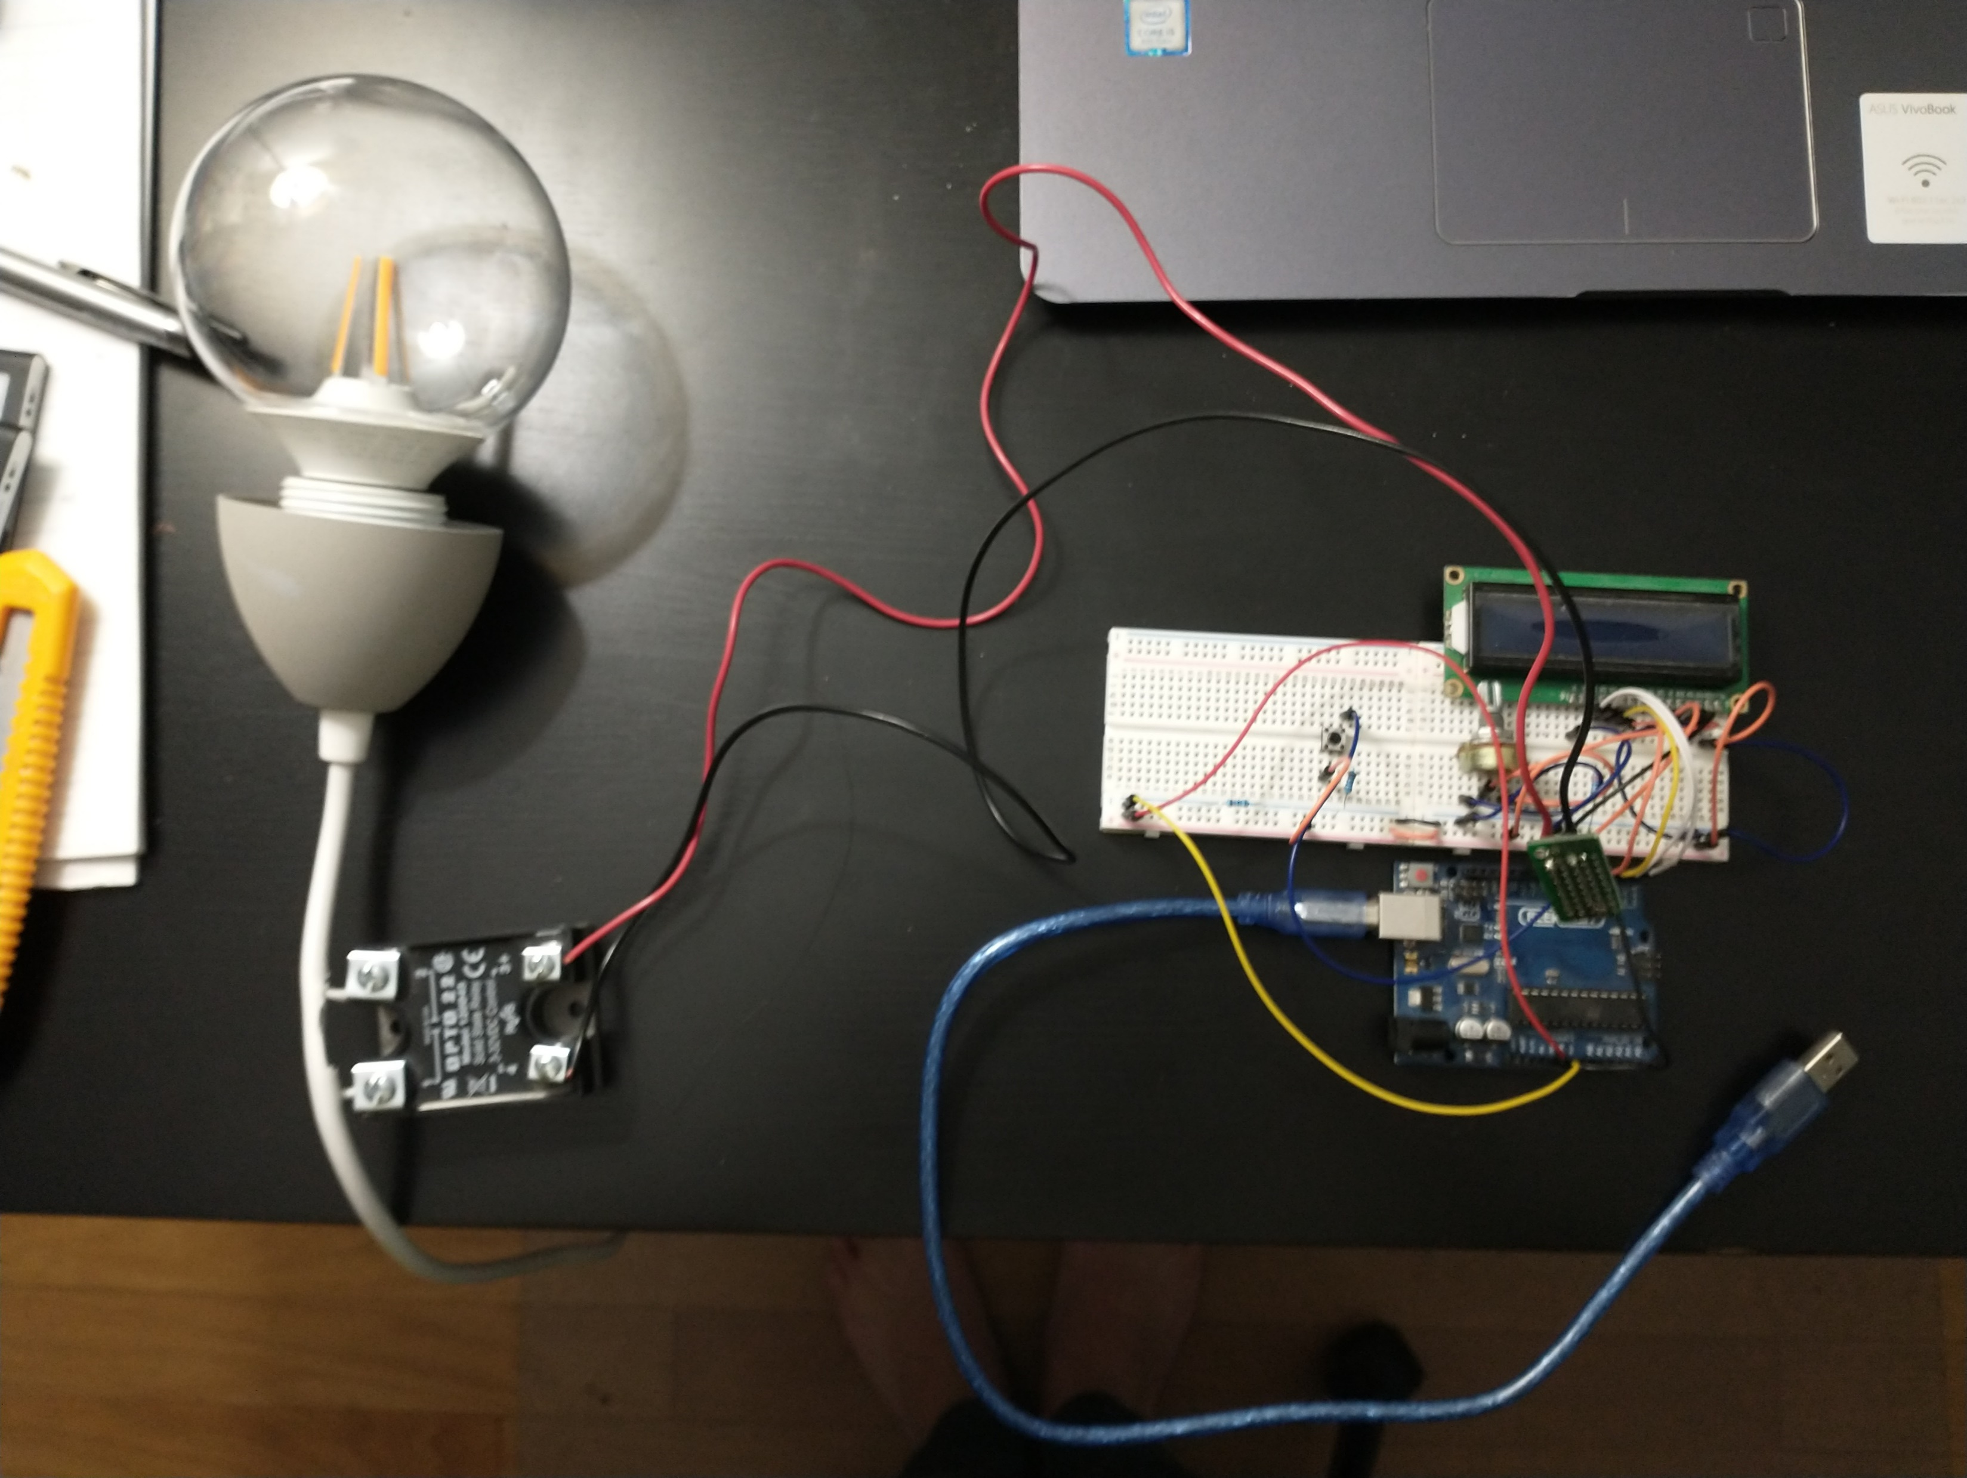
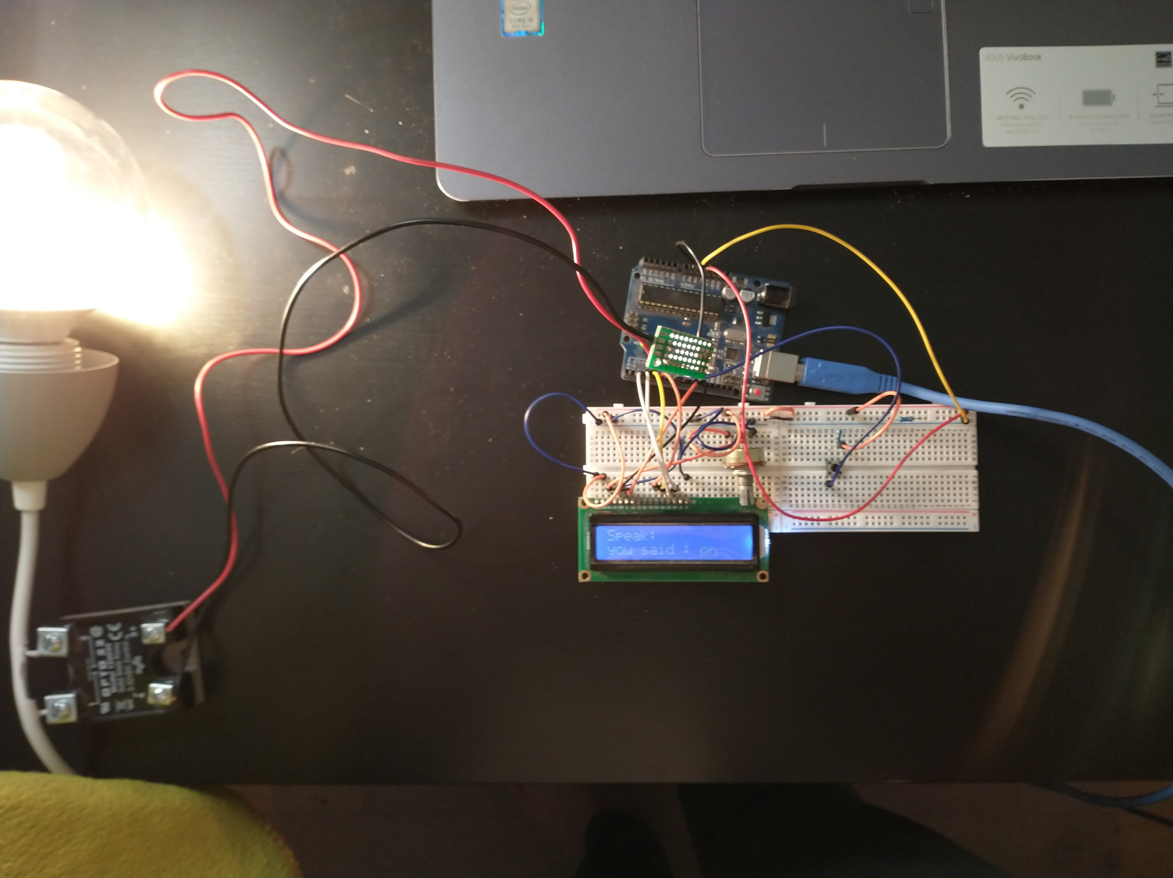
Remote Light System
Developed voice activated IoT lighting control with Python and Arduino integration
Used the PyFirmata, Speech Recognizer and Flask libraries to read user voice and develop a web app for the light controls
Used an LCD to display what was spoken and Solid State Relay to control the light

